Slide 1
GLASS Craft: 3D Printing Chinese Window Grilles
Qinghong Shao University of New Mexico
Notes:
Hello, my final project is called GLASS Craft: 3D Printing Chinese Window Grilles. The inspiration for this project comes from the traditional window structures of my hometown with a history of more than thousands of years. Like the pictures, these are beautiful.

Slide 2
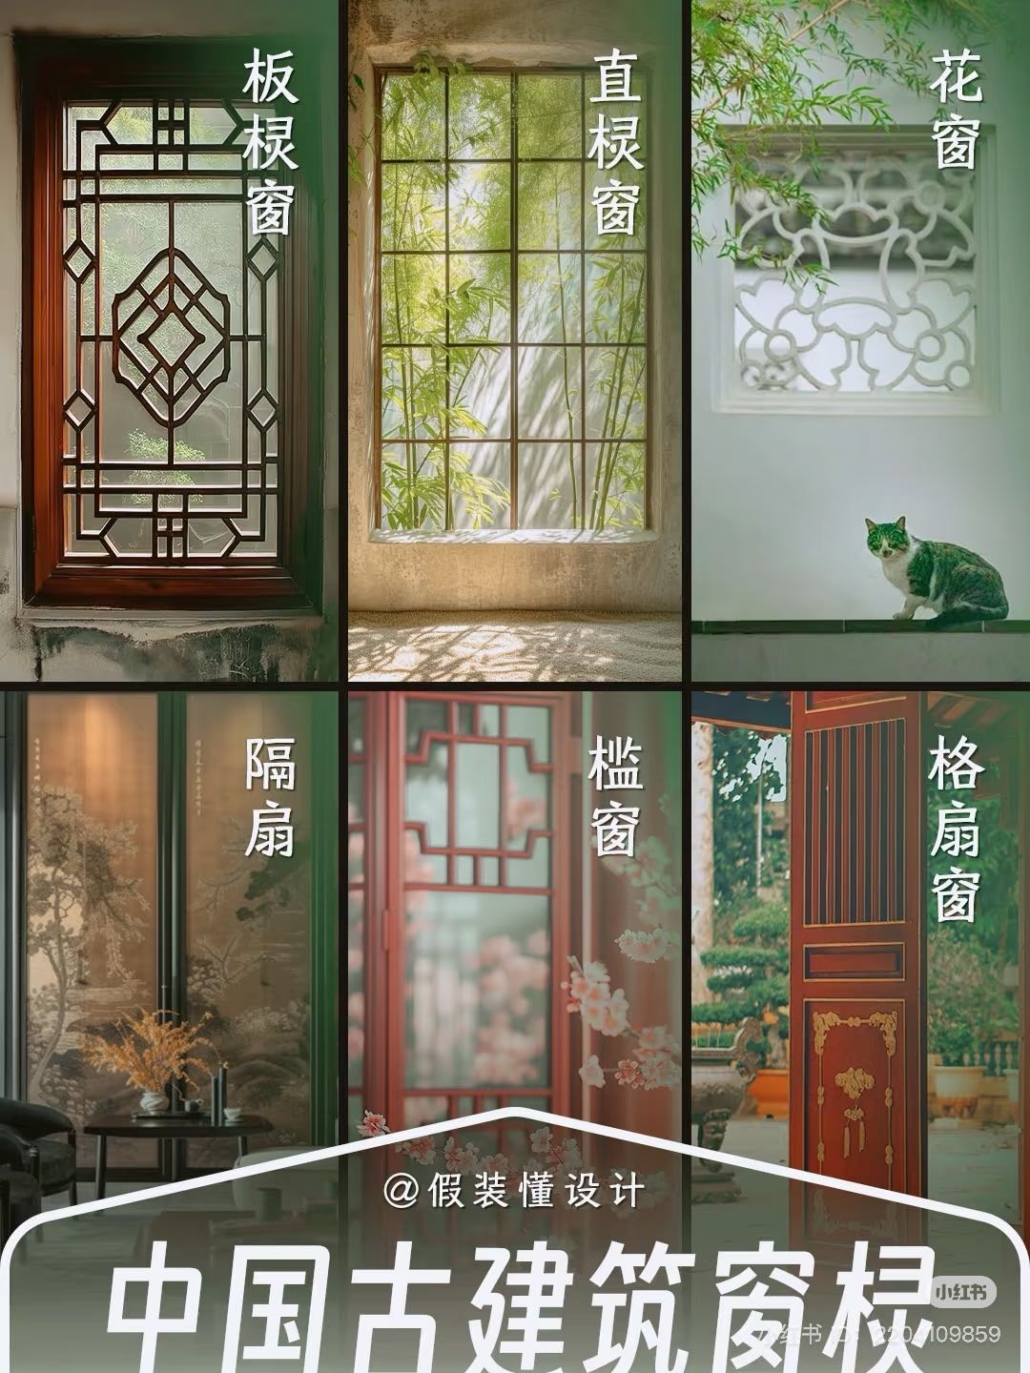
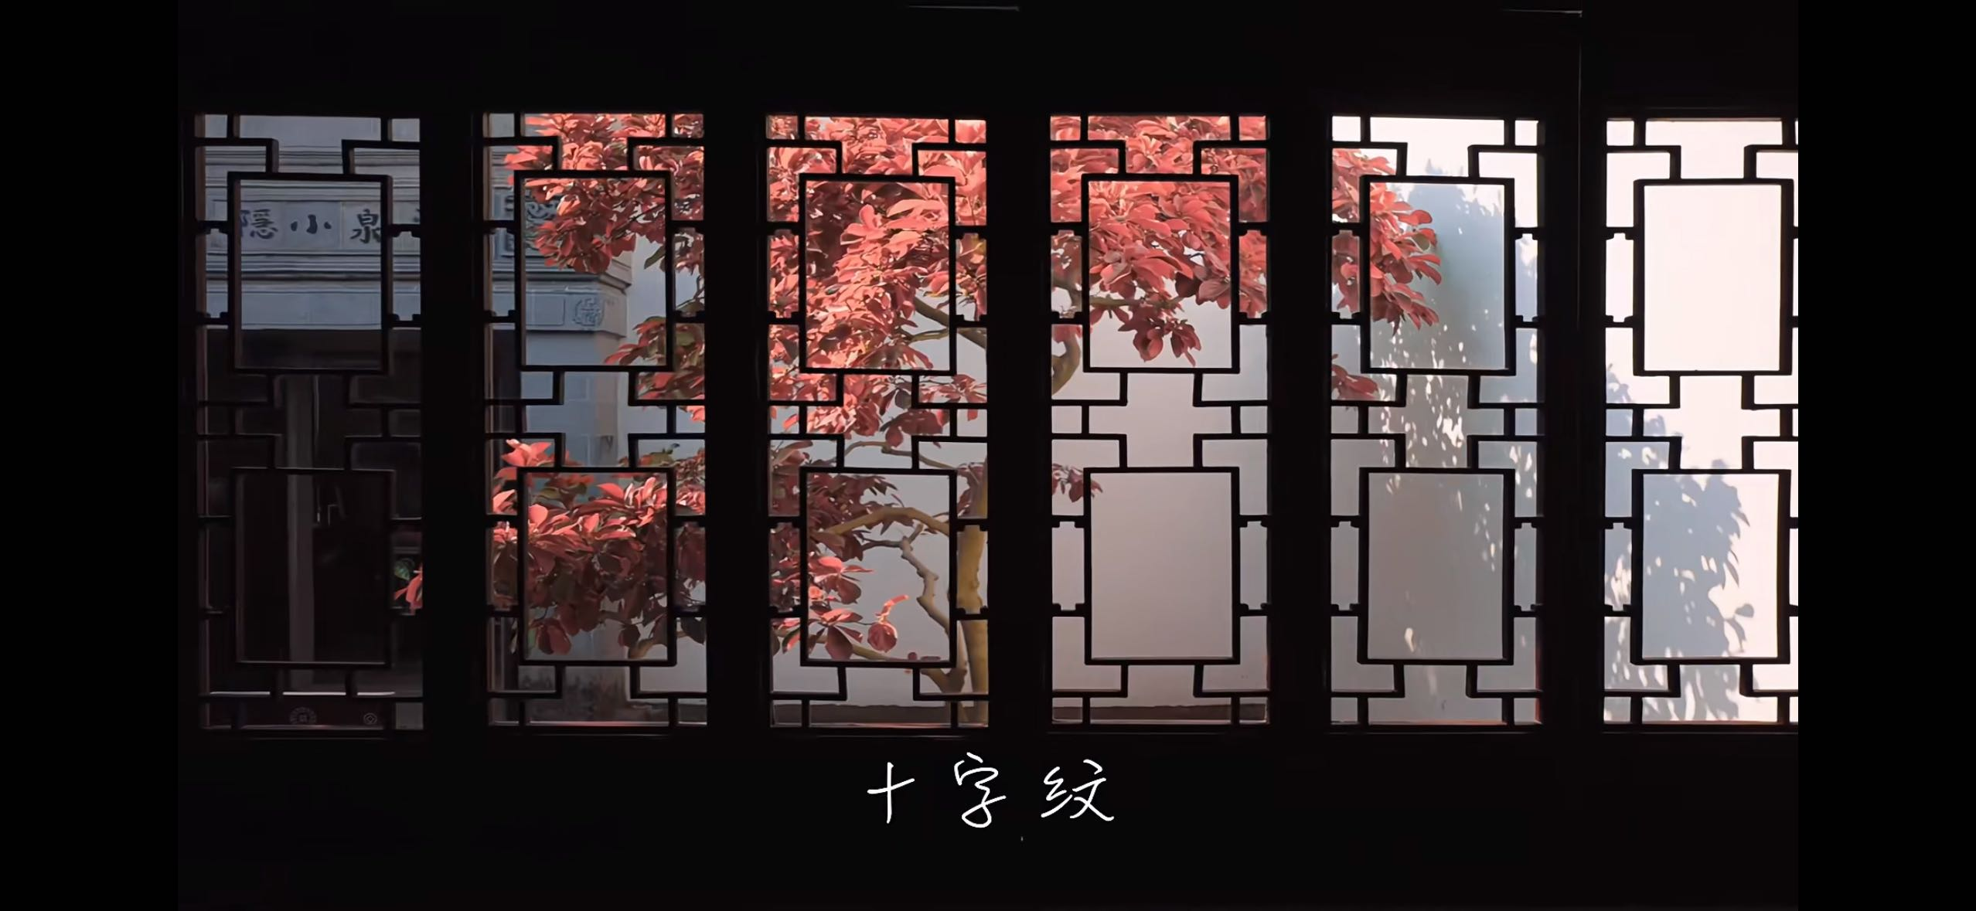
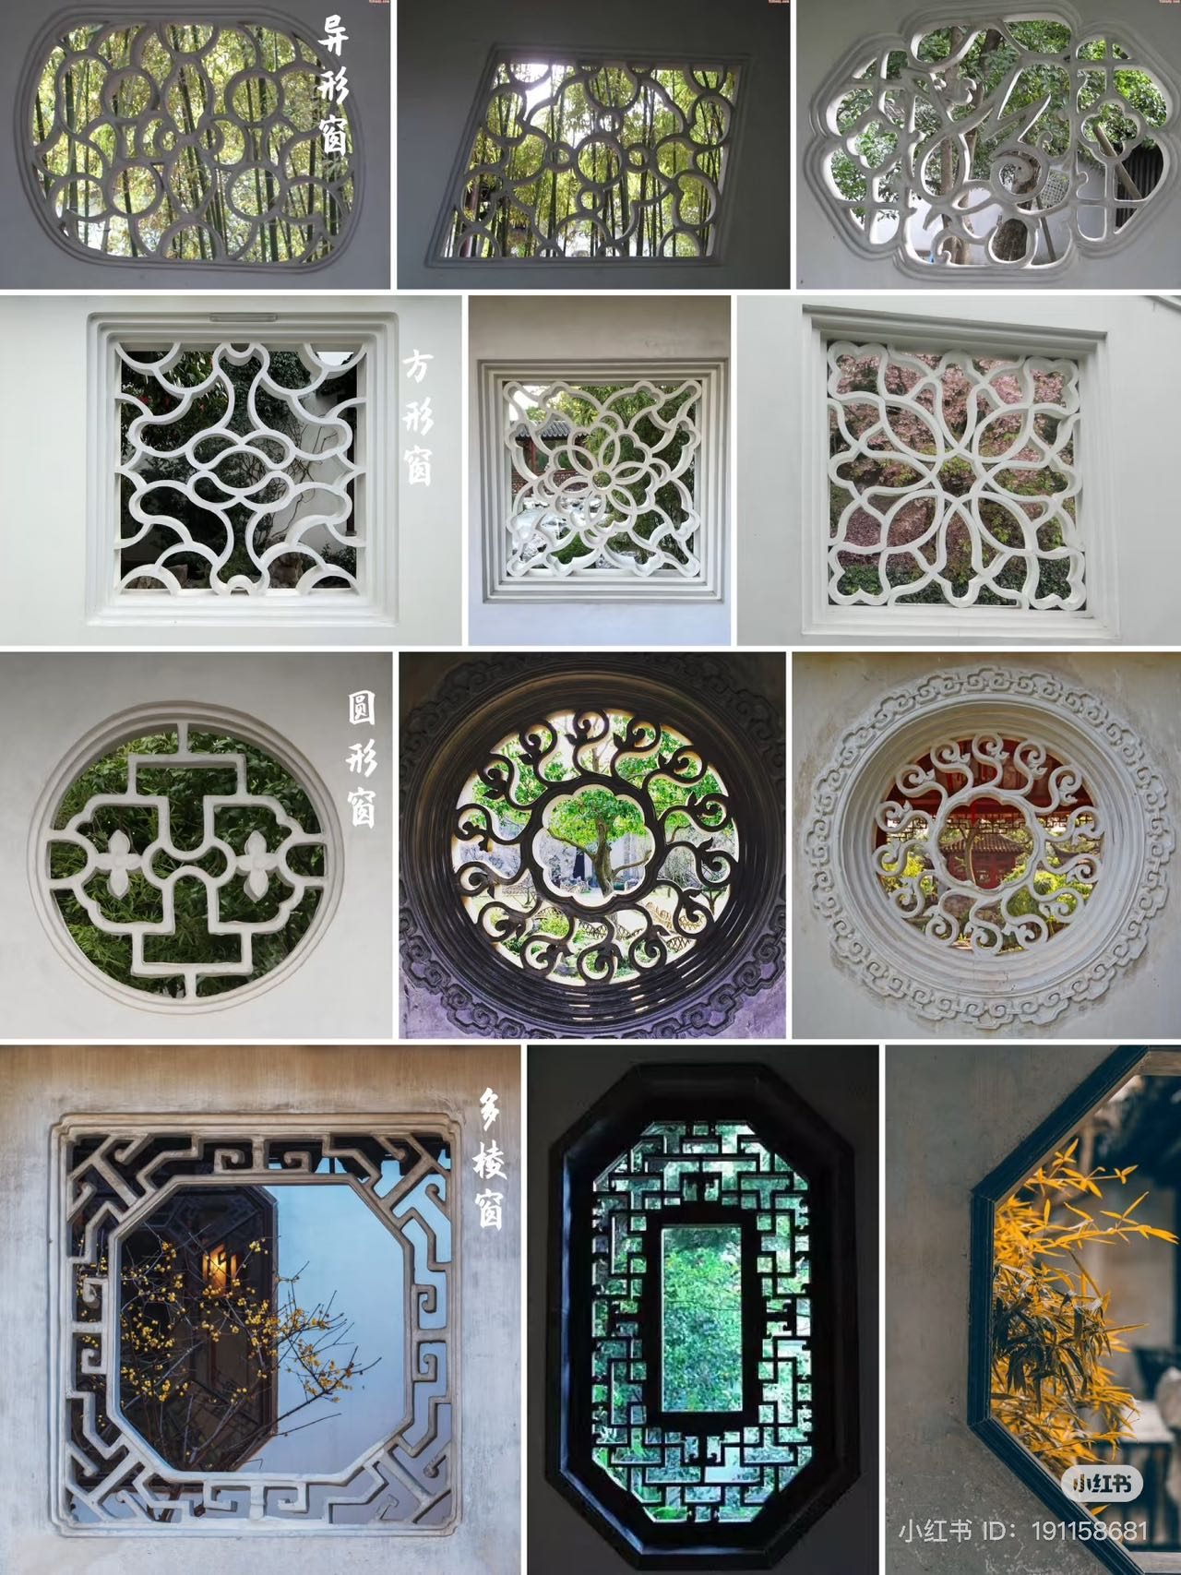
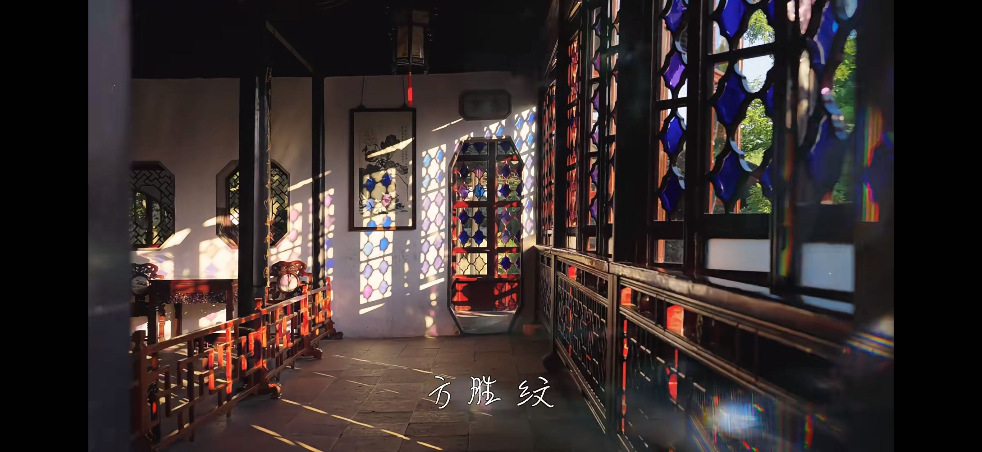
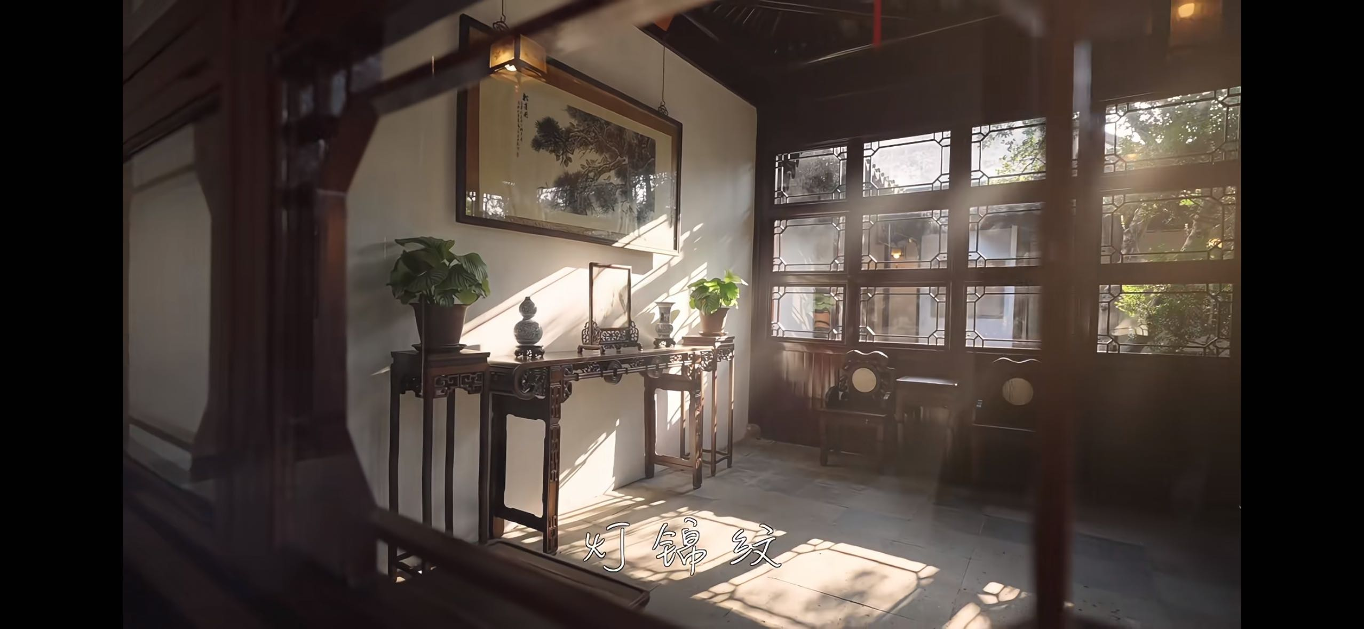
Notes:
Hello, my final project is called GLASS Craft: 3D Printing Chinese Window Grilles. The inspiration for this project comes from the traditional window structures of my hometown with a history of more than thousands of years. Like the pictures, these are beautiful.

Slide 3
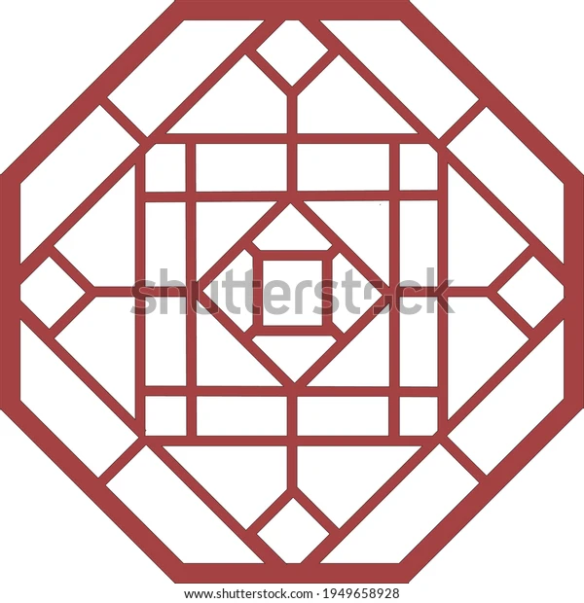
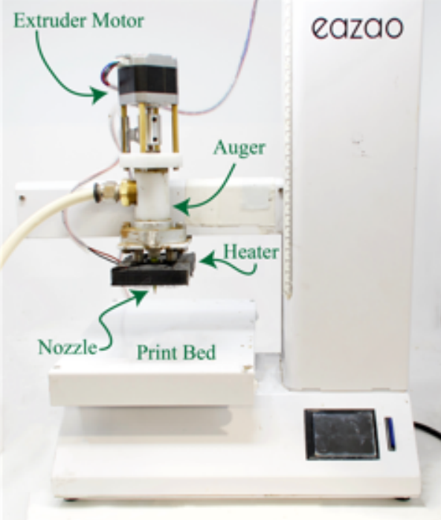
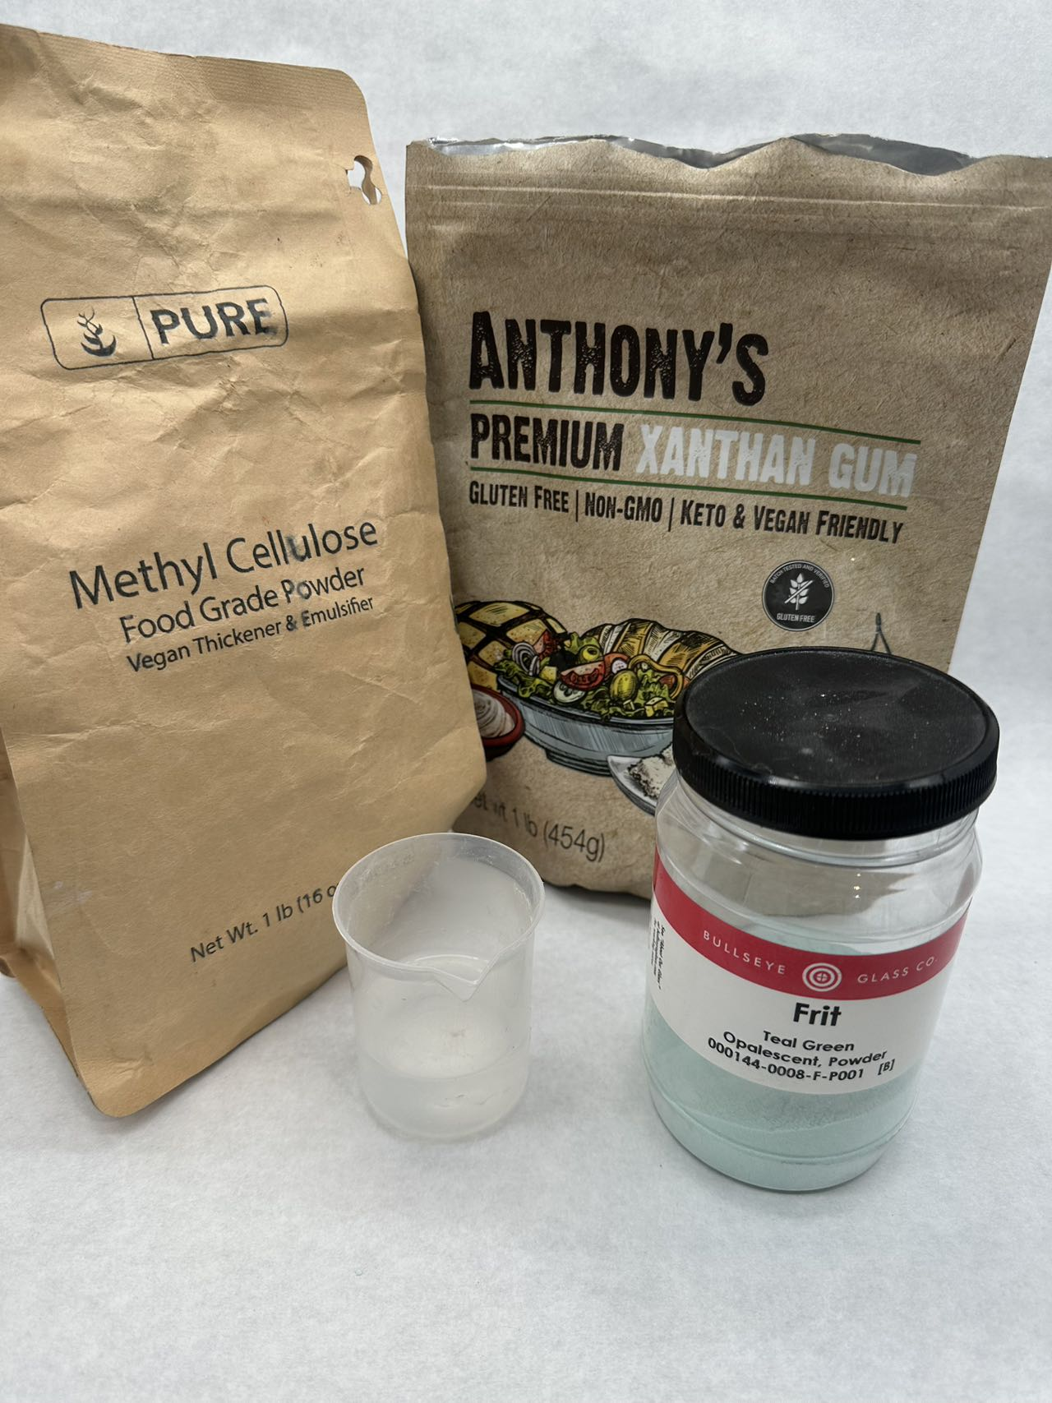
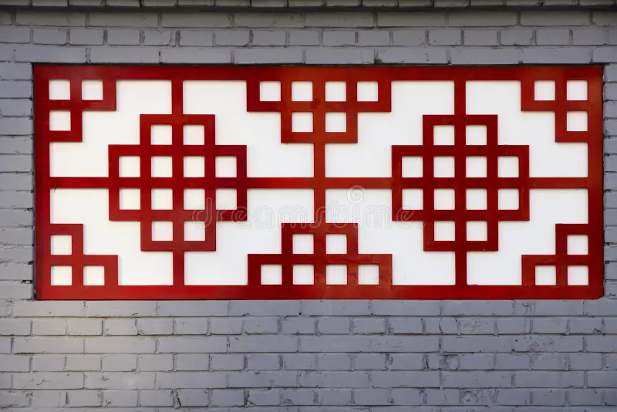
Introduction
Eazao Printer
Material
Window Grilles
Notes:
My theme is to explore the combination of modern technology, 3D printing technology, and traditional window structures and glass art.
I brought glass artworks and the work done with clay in the last assignment. Through comparison, you can better experience the characteristics of different printing materials.

Slide 4
Process
TurtleLibrary
Toolpath
GlassFrit..。
Material
Eazao Printer
Printing
Frying
Kiln
Notes:
My project is divided into four processes, designing ToolPath, mixing materials, printing, and firing.

Slide 5
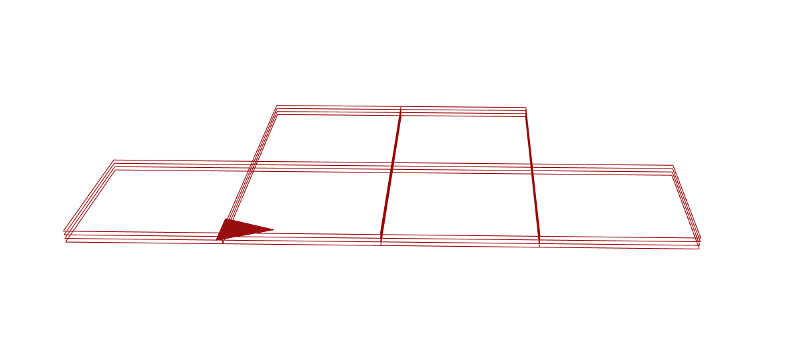
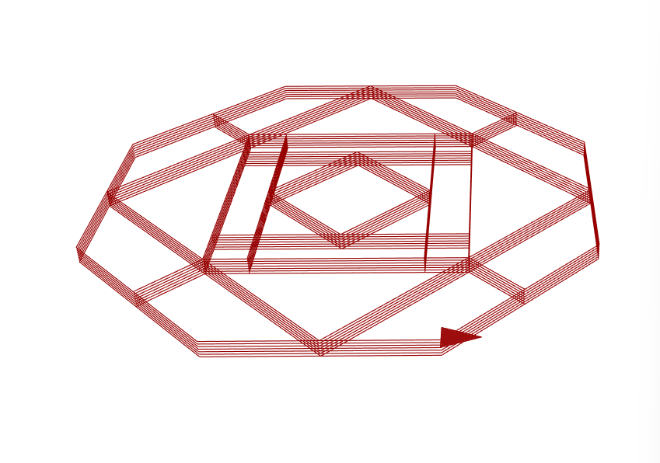
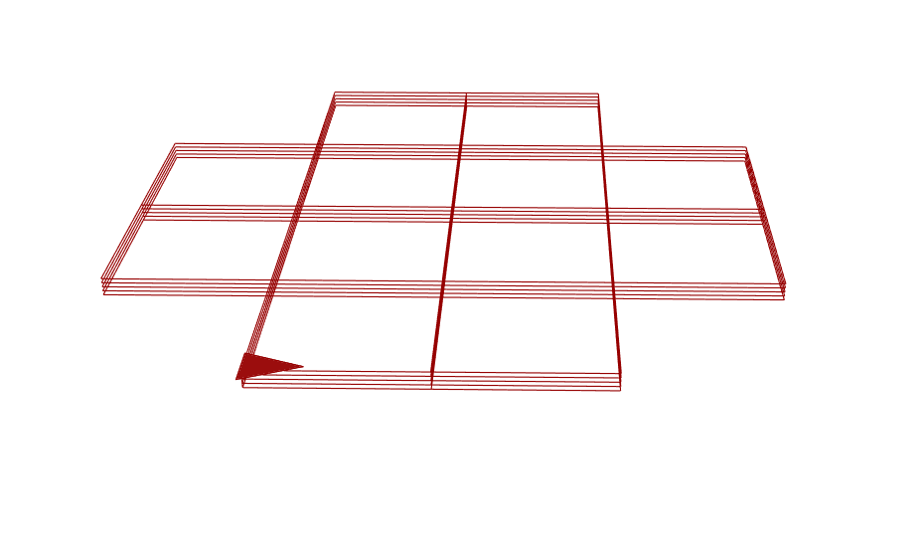
ToolPath
Notes:
When designing the window, I used Turtle Library to produce ToolPath myself, so that I can get the expected shape during the printing process.

Slide 6
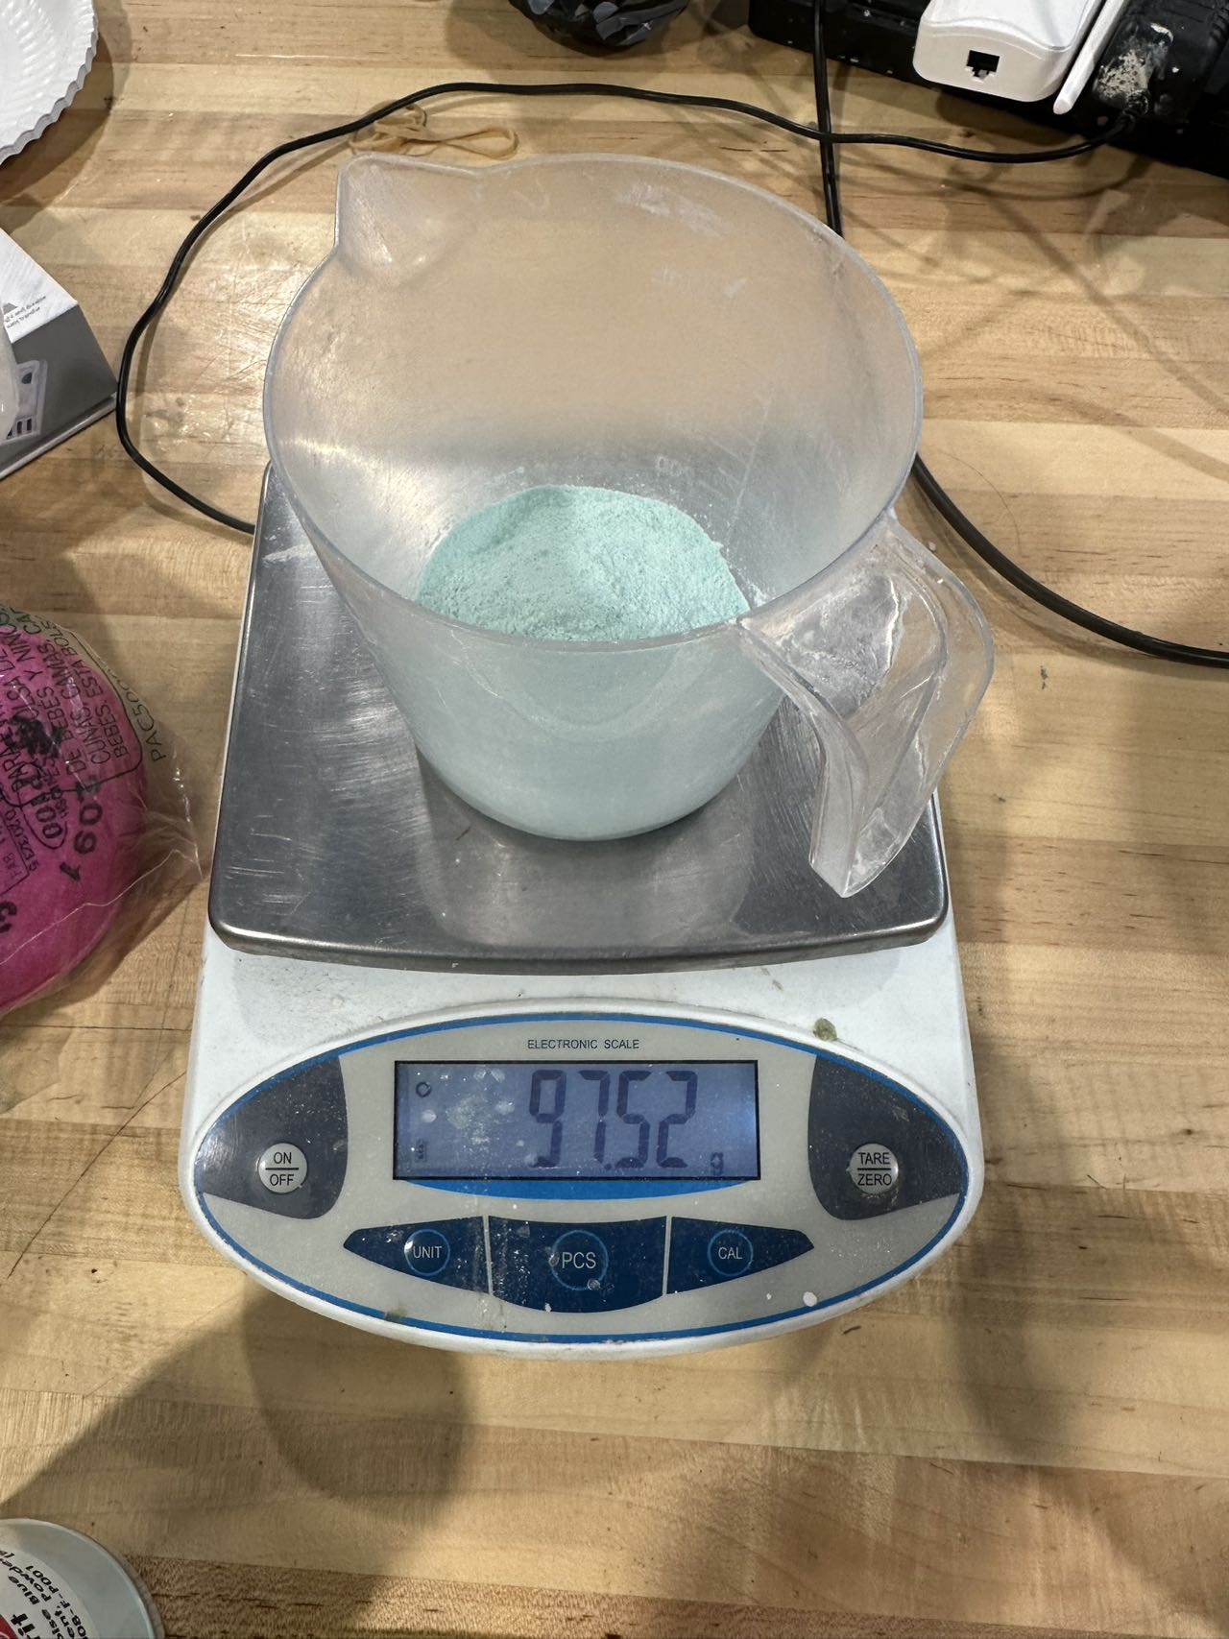
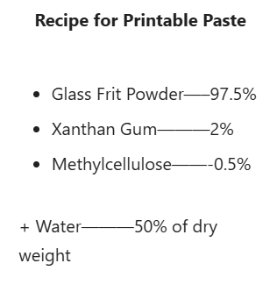
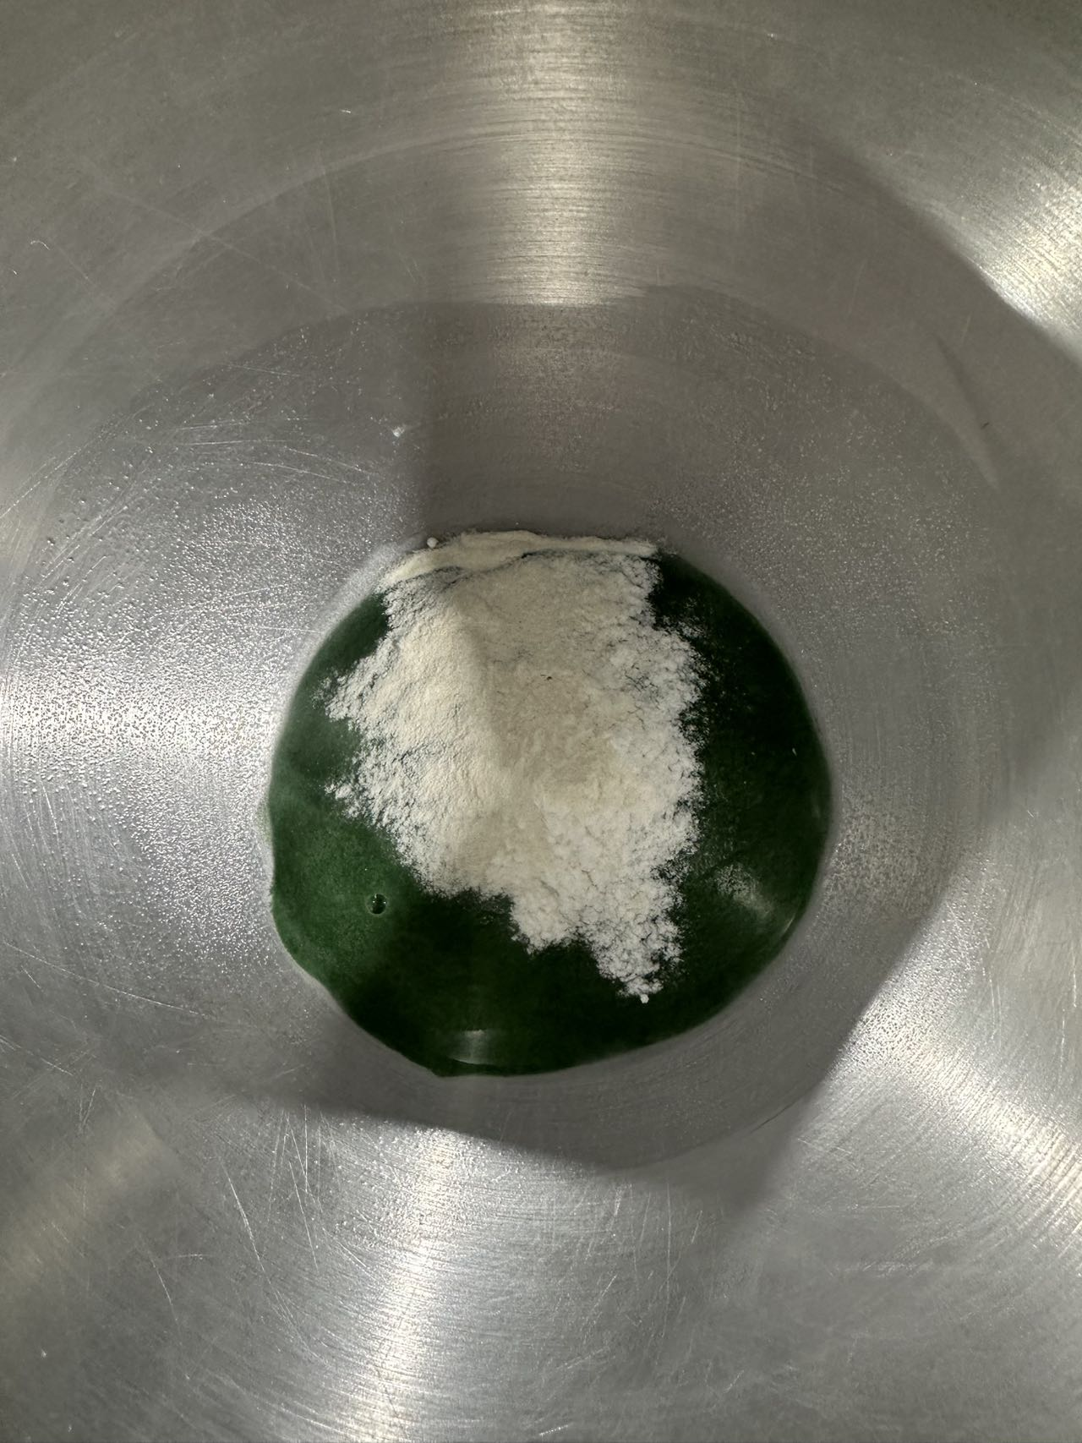
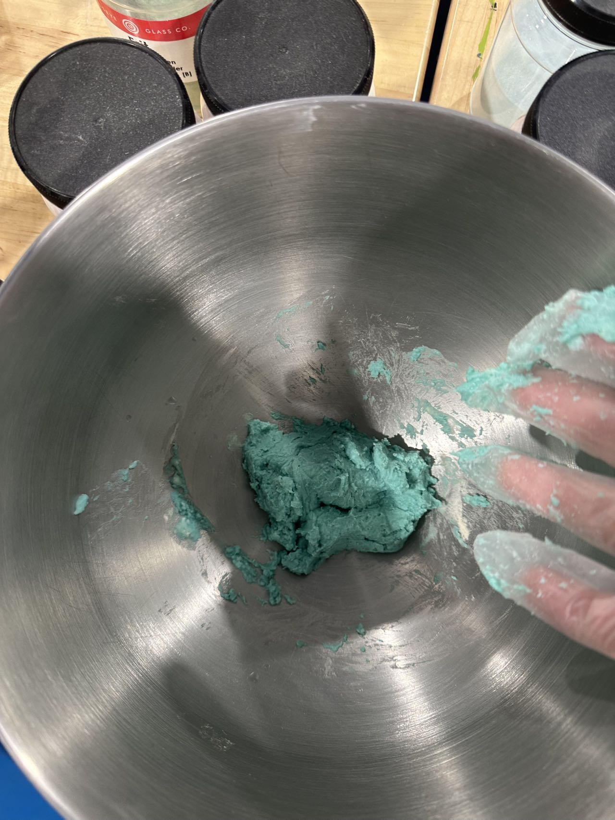
Material
Notes:
The second step is to mix Glass Frit Powder, Xanthan Gum and Methylecllulose in proportion into a paste. During the mixing process, make sure that the final printed material has no lumps and bubbles.

Slide 7
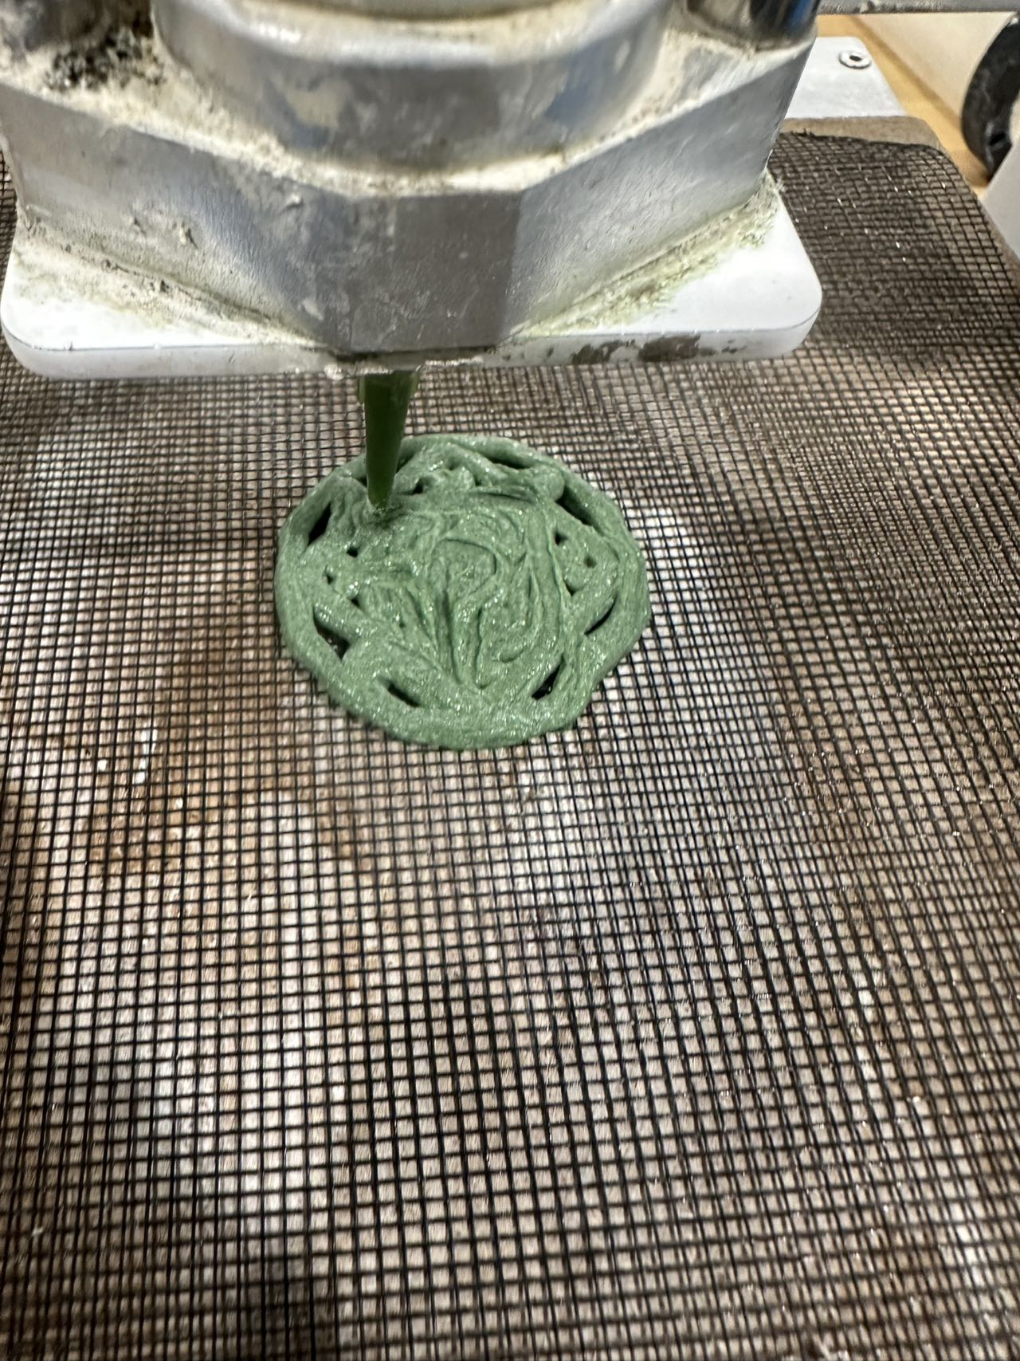
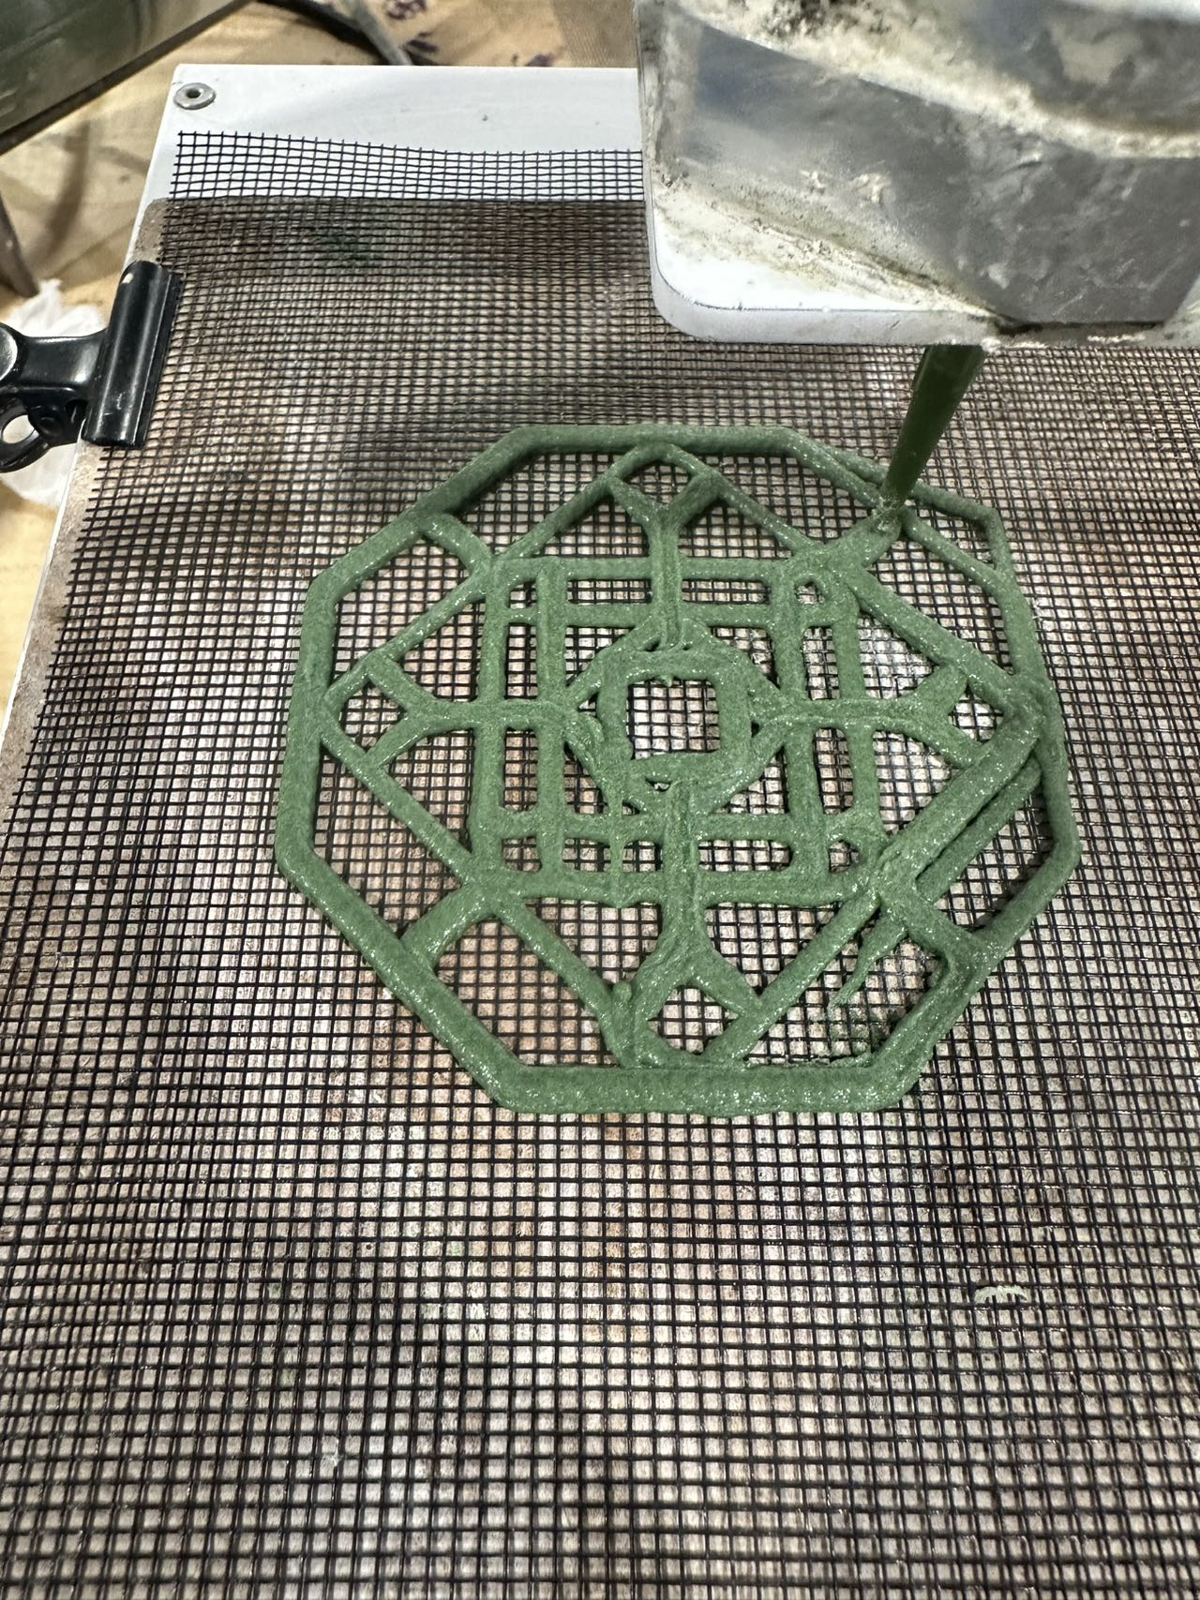
Printing
Cura ToolPath
Improved ToolPath
Eazao Printer
Notes:
The third step is printing. The Eazao printer pusher squeezes the glass paste material into the nozzle to complete the printing. The printing path has a strong connection with the final effect. The upper right corner is based on Cura cutting. Because there are too many Travelpaths, the useless path, it will destroy the original printed part during the movement.The lower right corner is based on the Toolpath optimized by my own route, which reduces the moments of trave, and can get better printing results.

Slide 8
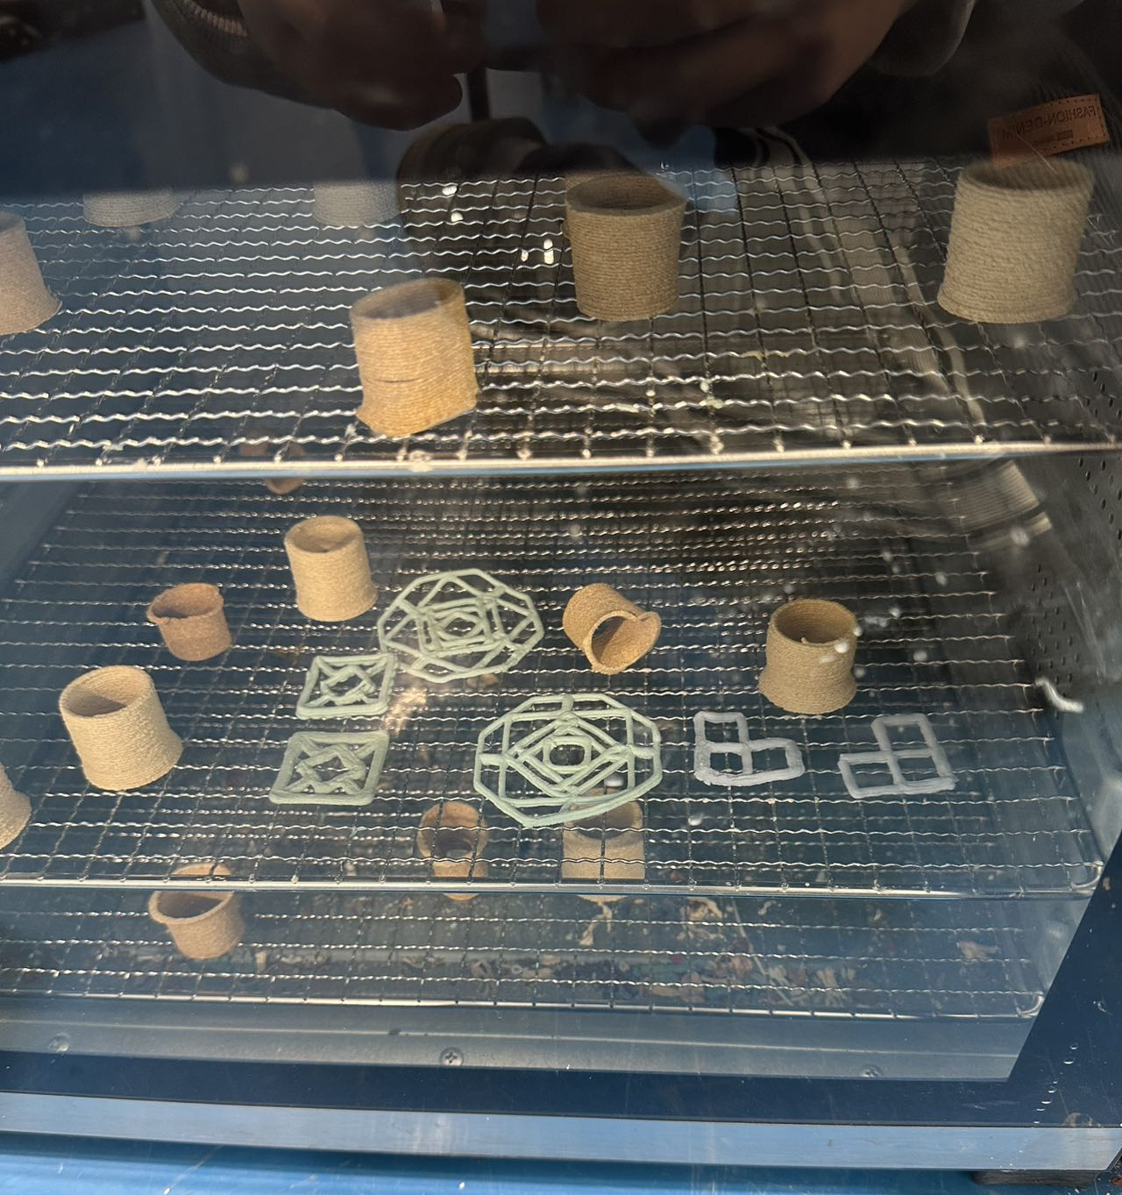
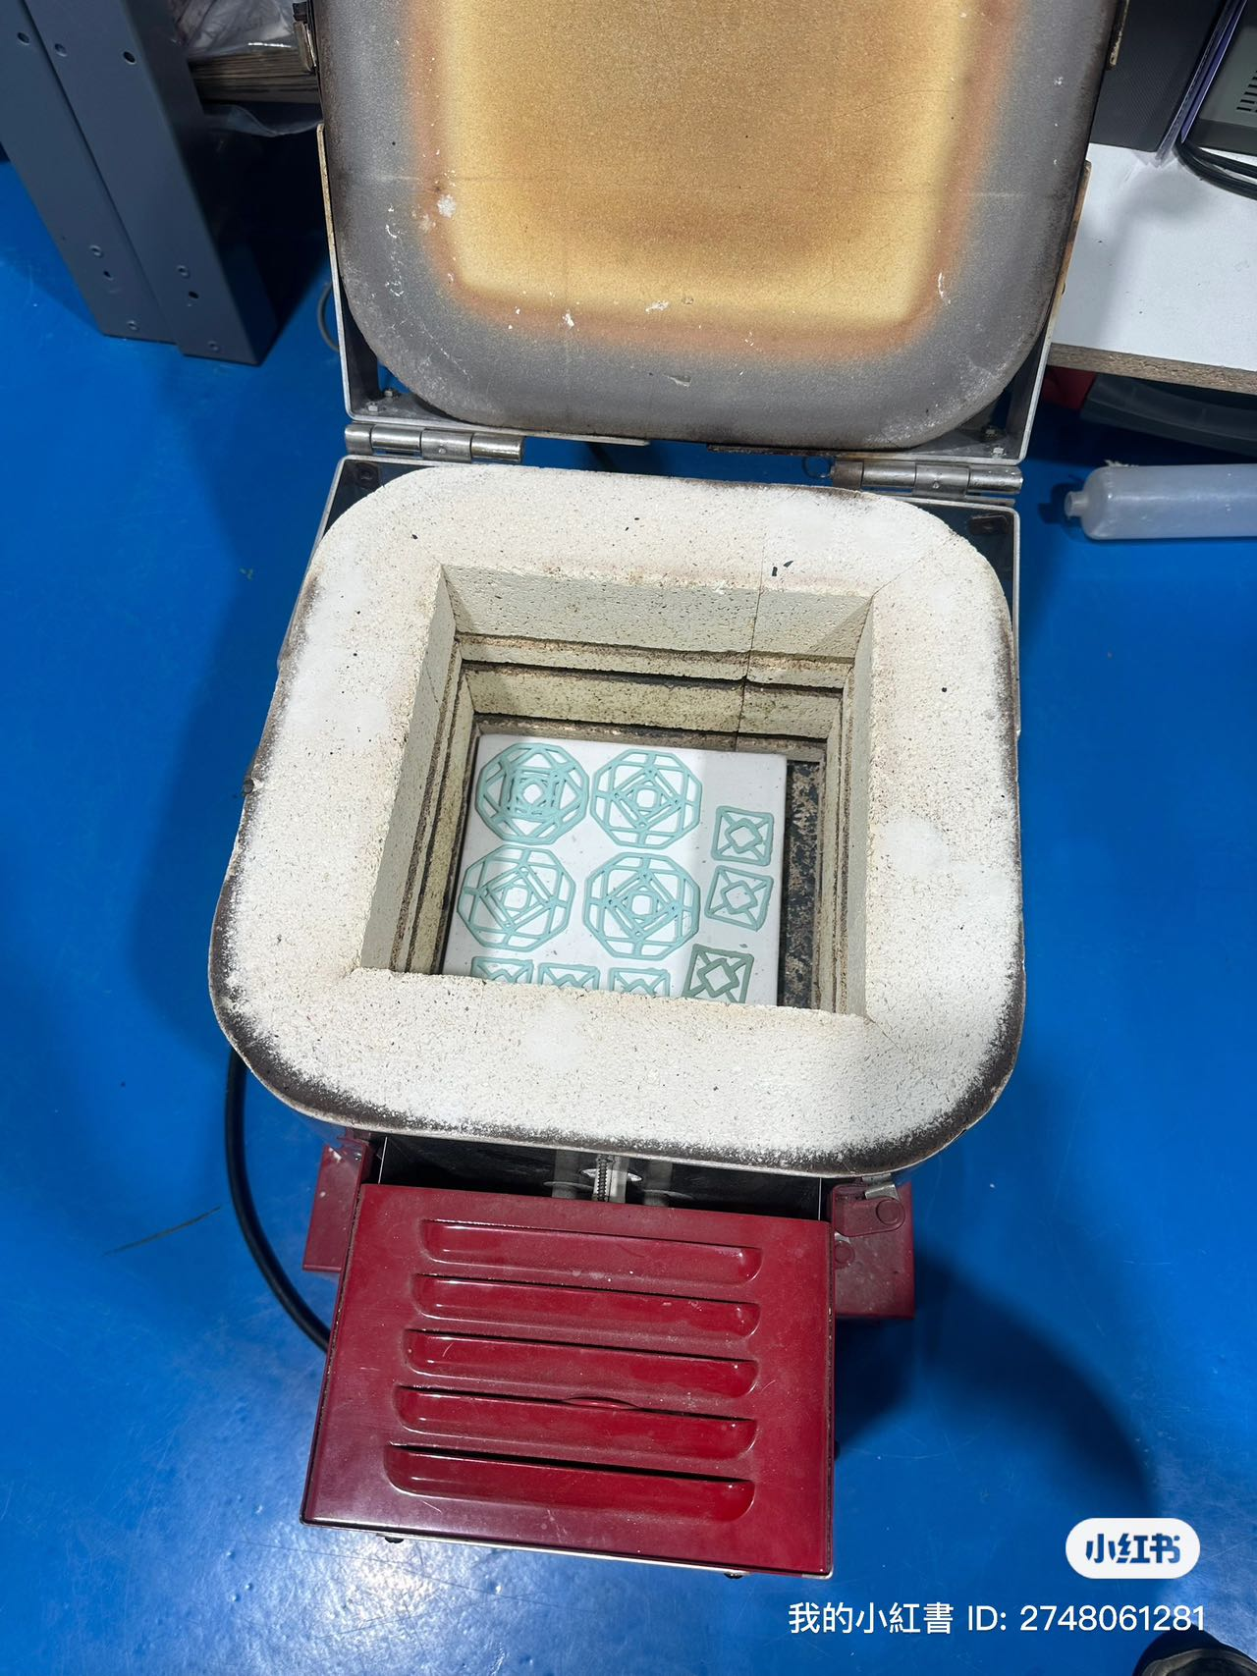
Printing
Drying
Put them into kiln
Notes:
After printing, put the results into the heater to dry and remove moisture, and then put them into the Kiln for firing.

Slide 9
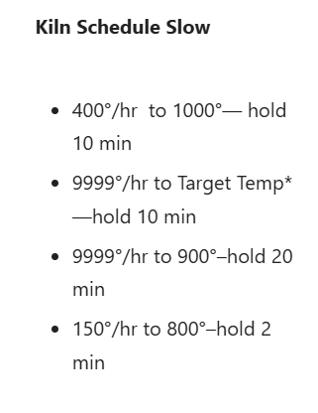
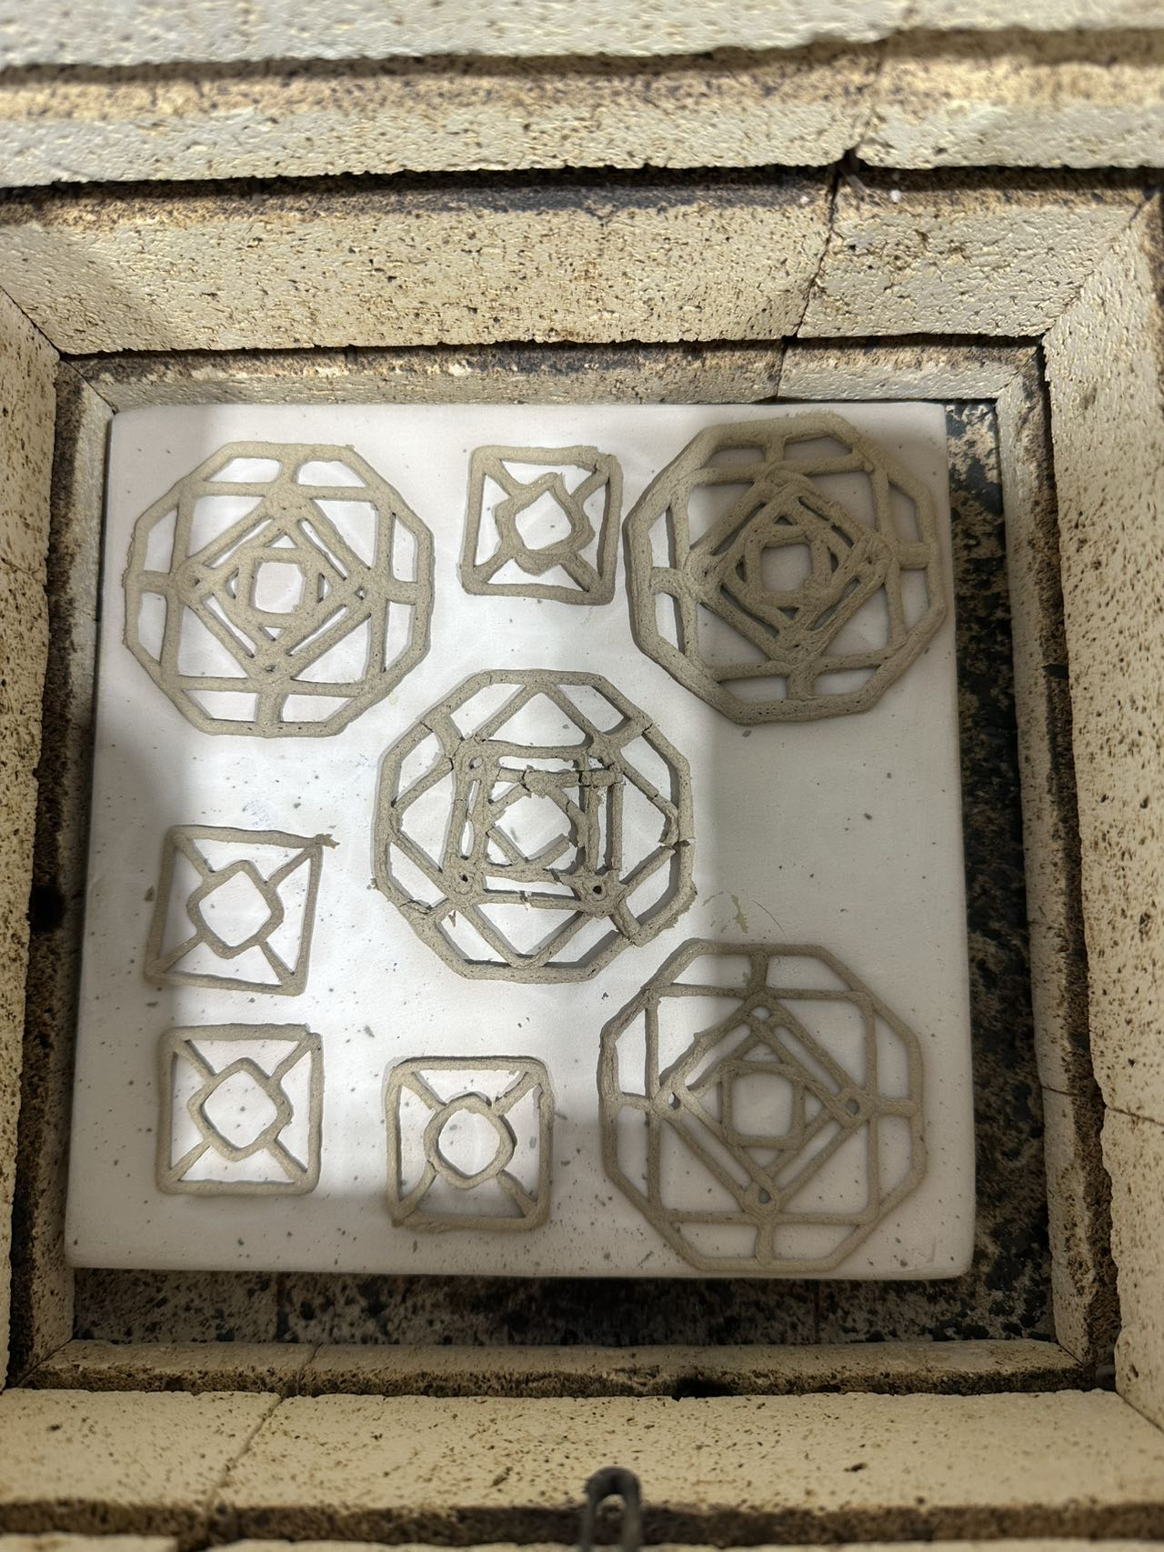
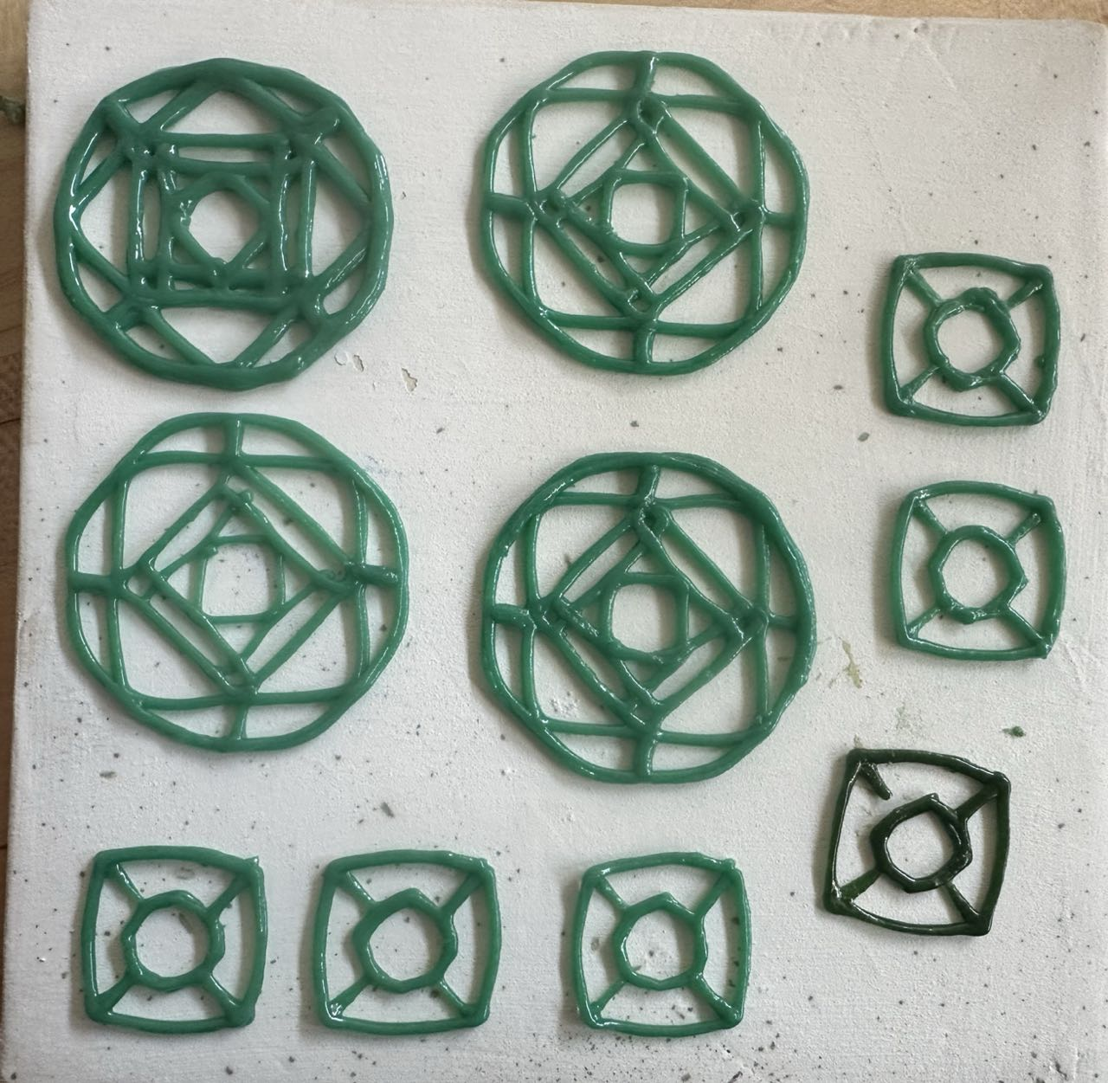
Frying
Wrong Firing Temperature
Suitable Firing Temperature
Notes:
Glass materials are very sensitive to temperature changes. As shown in the left picture, I set the temperature data in Celsius, which caused the temperature to be too low, and the final firing result was ash. When I corrected the error with the help of Leah, changed Celsius to Fahrenheit and fired again, I got a good result, as shown in the right picture.

Slide 10
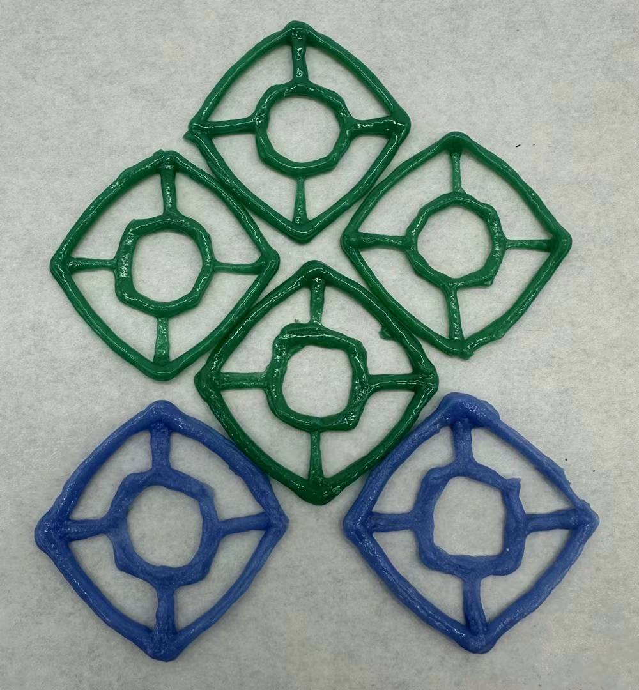
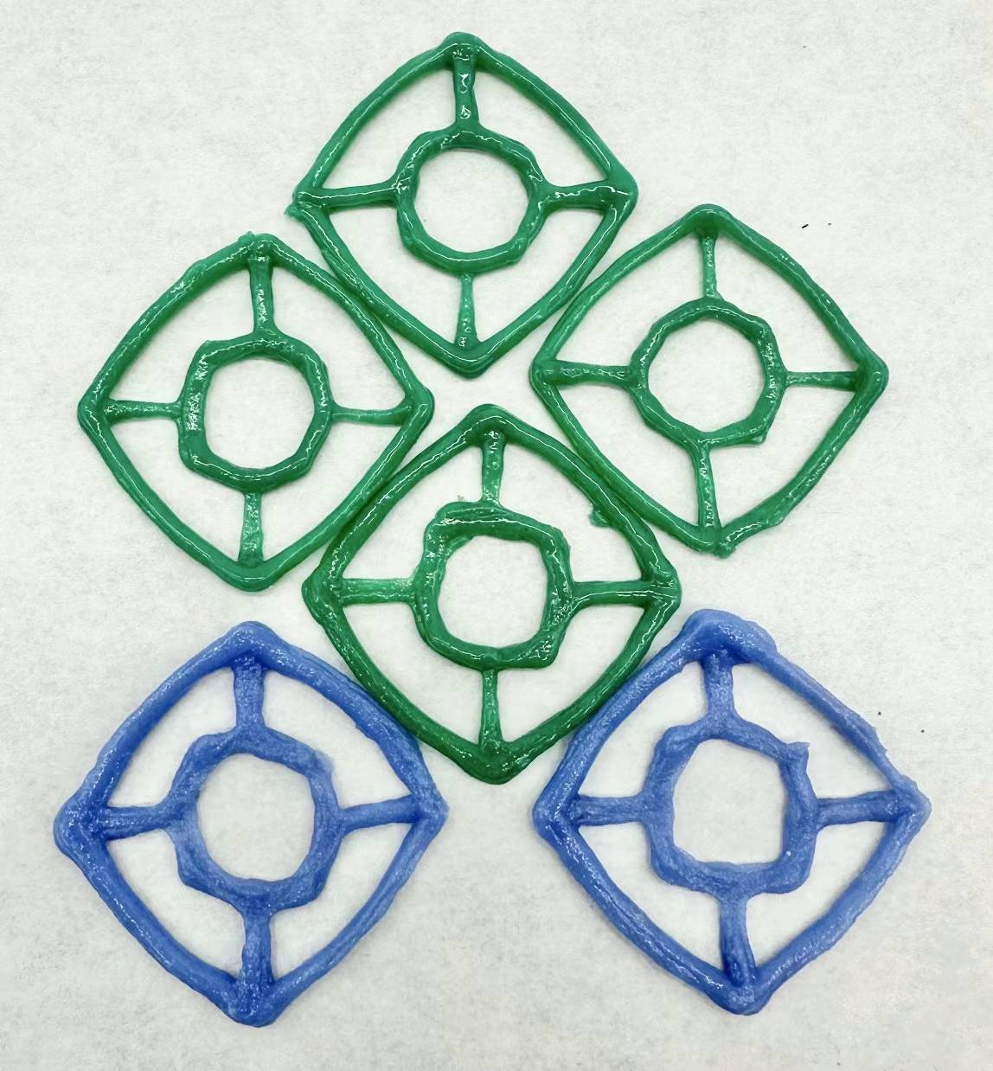
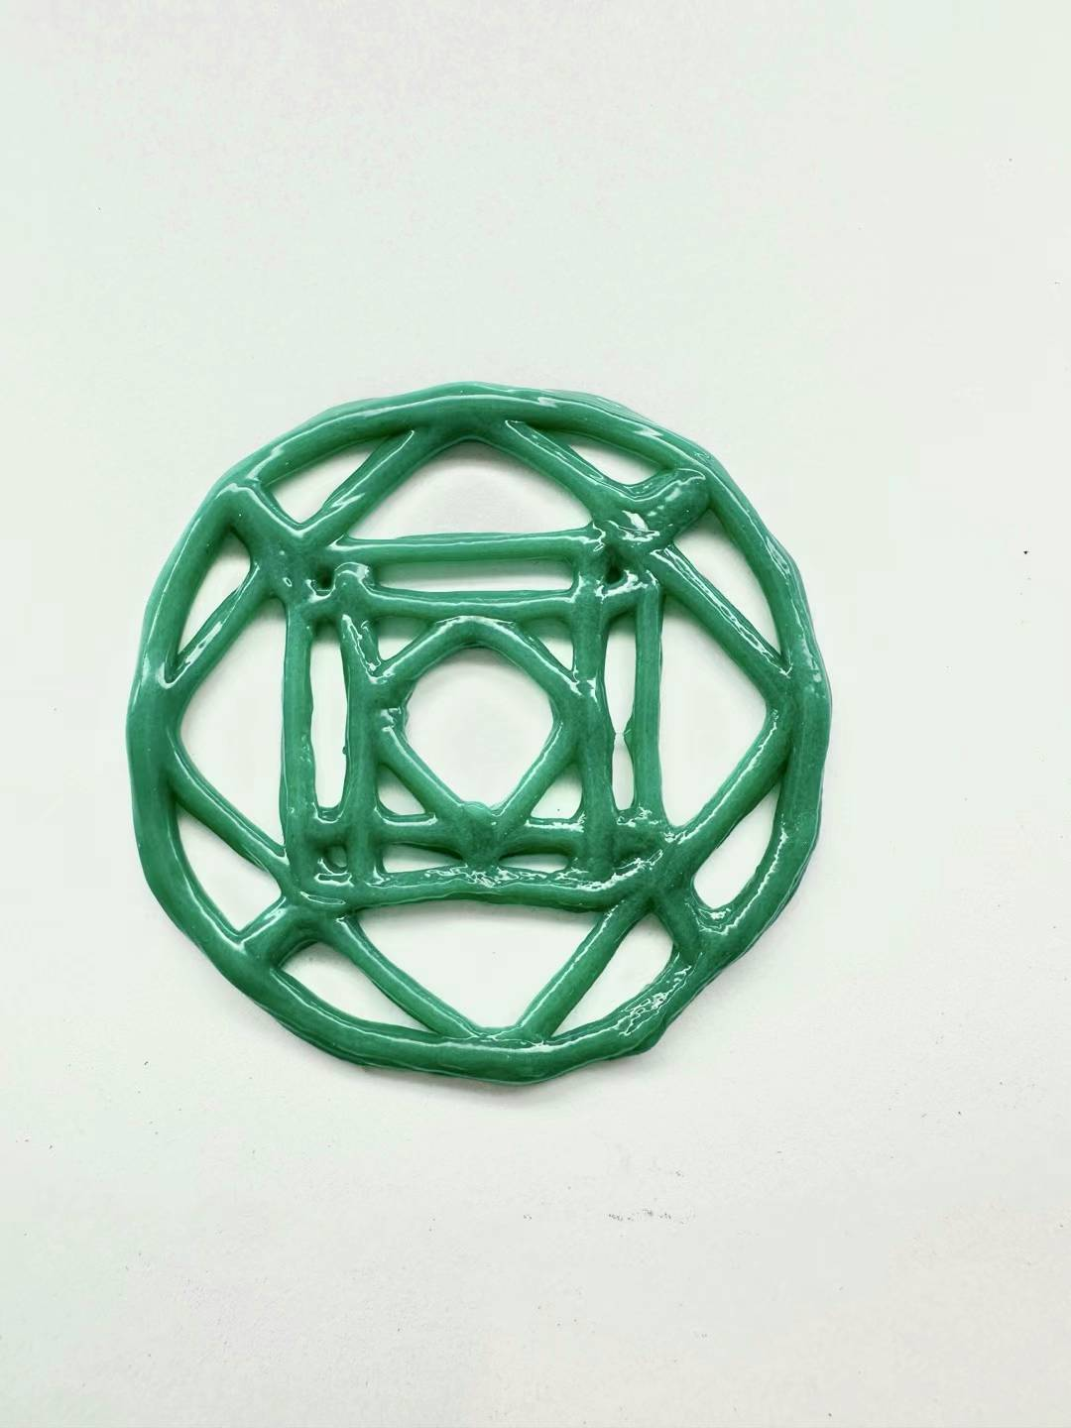
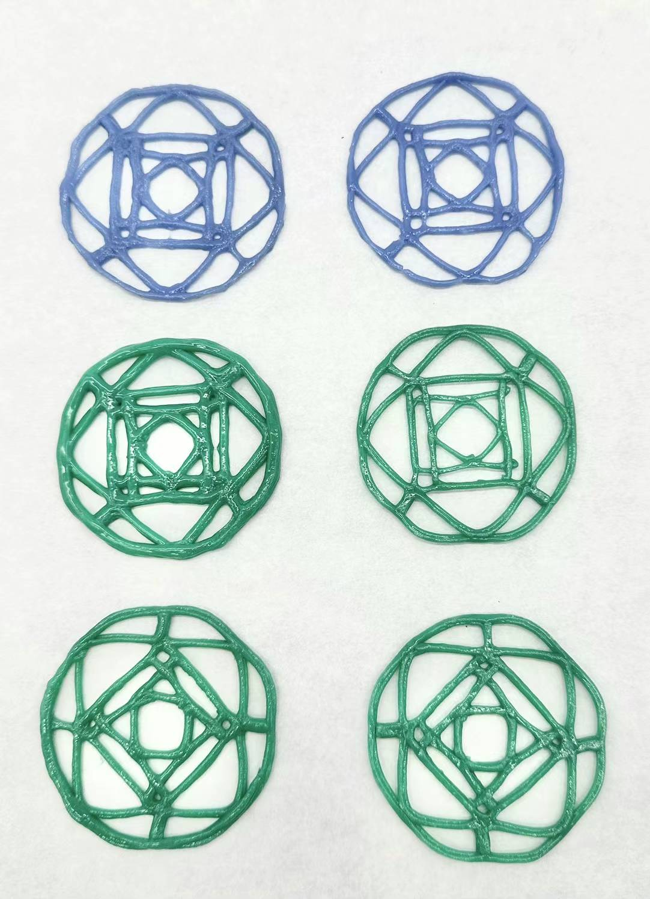
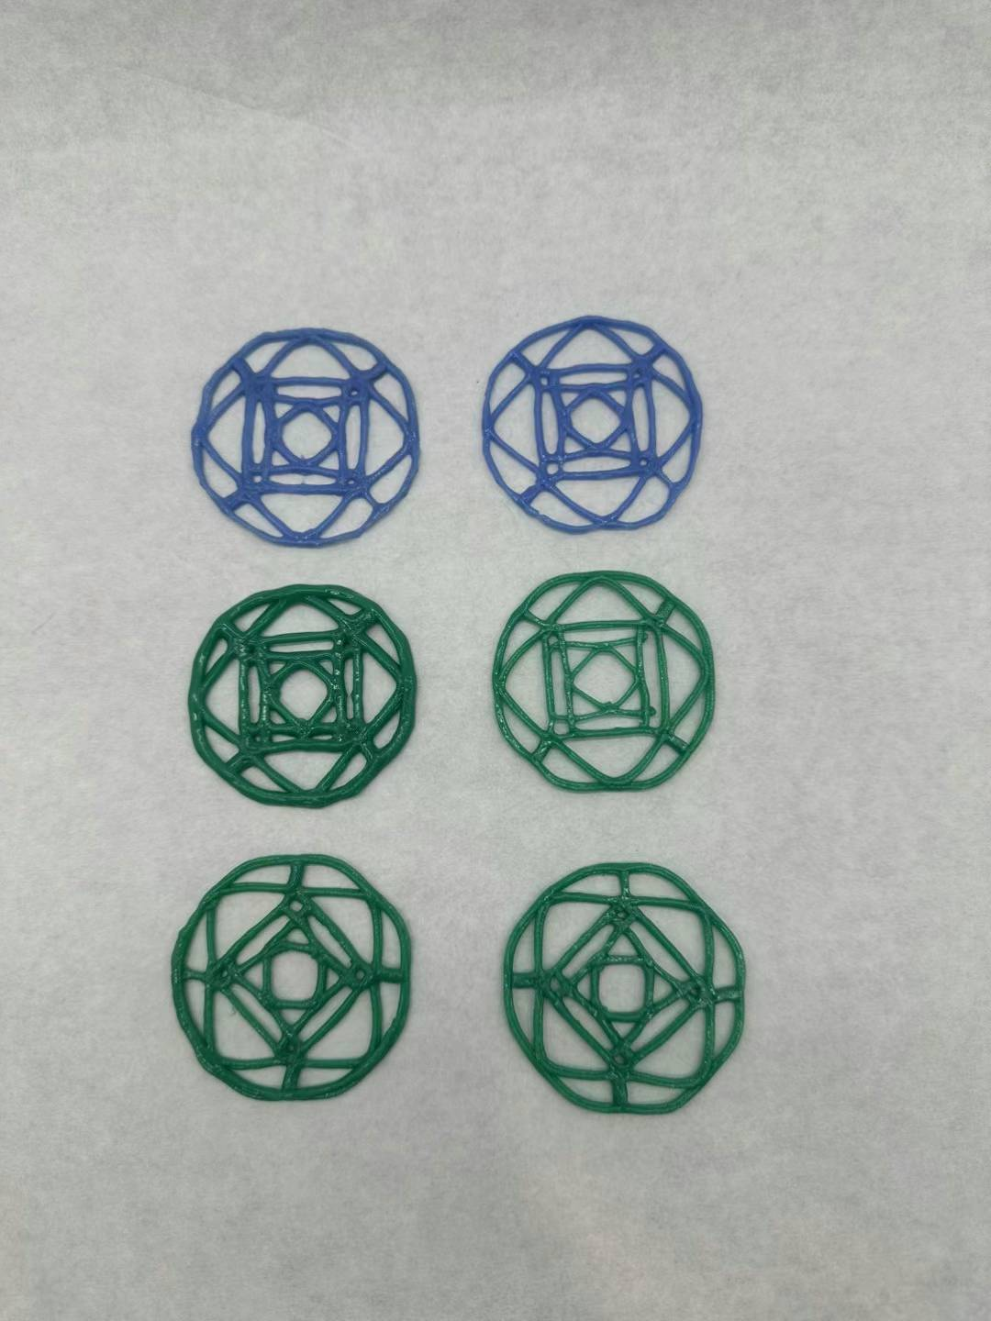
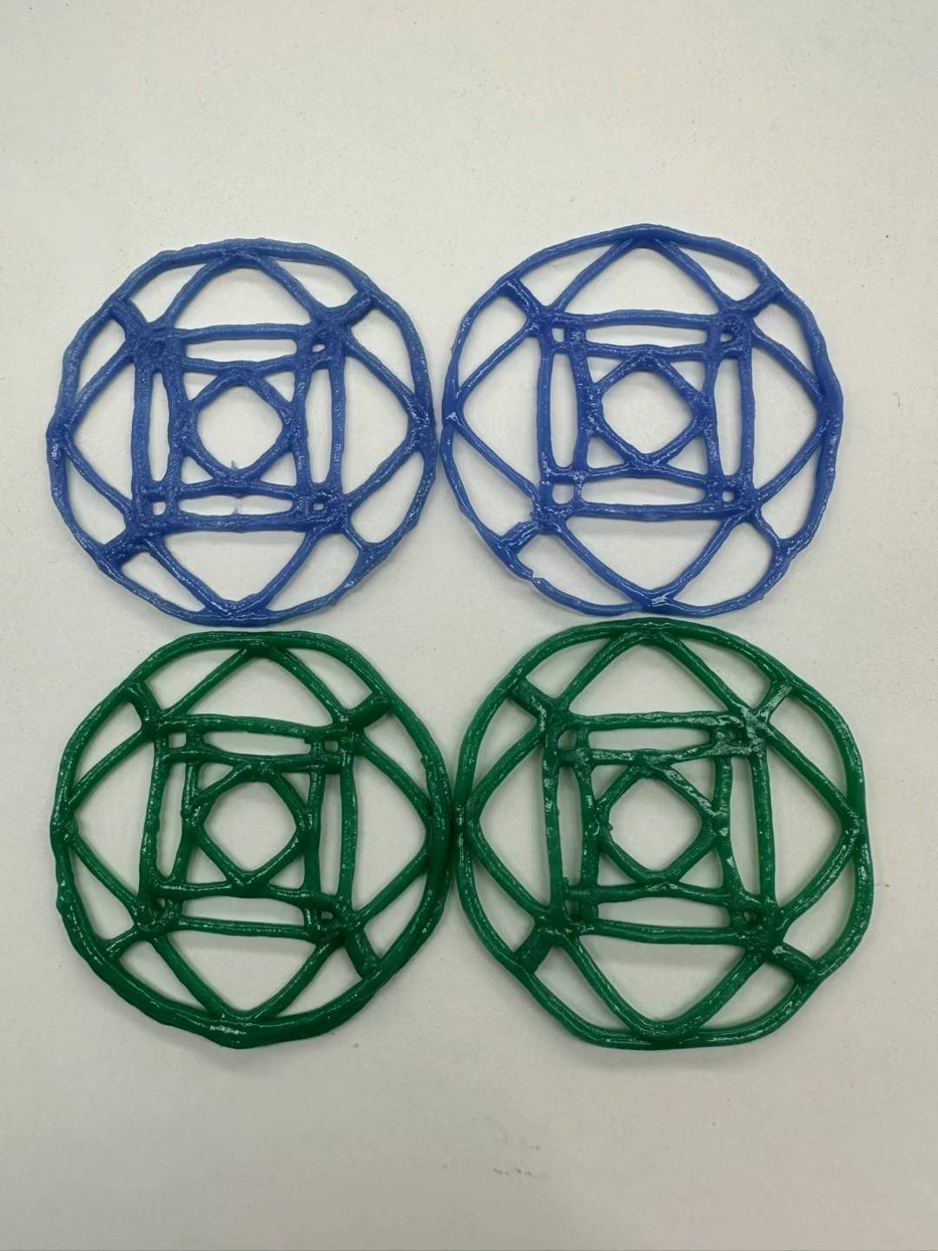
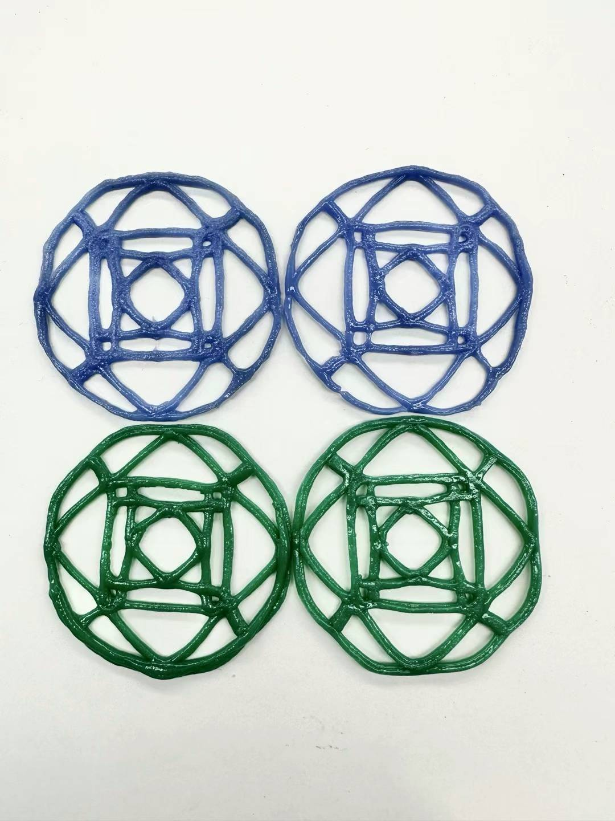
Notes:
The following are some of my final printed results. When I saw them reflecting light under the light, I thought they were beautiful. Not only are they glassy and reflective, but they are also the good results I finally got after trying and failing again and again.

Slide 11
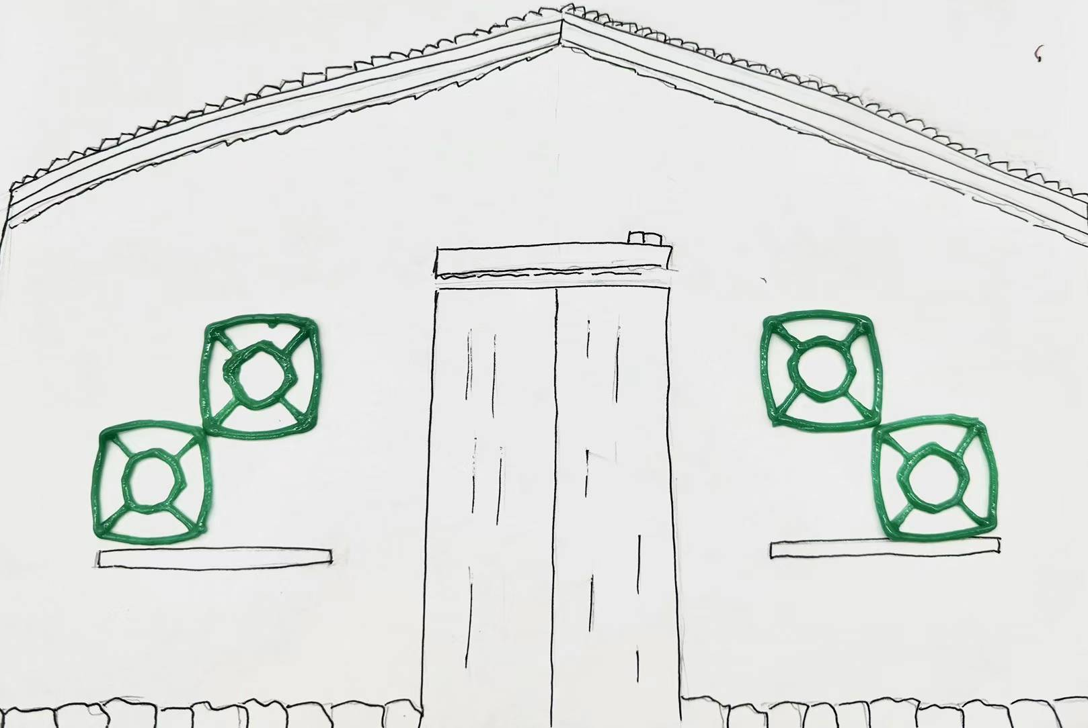
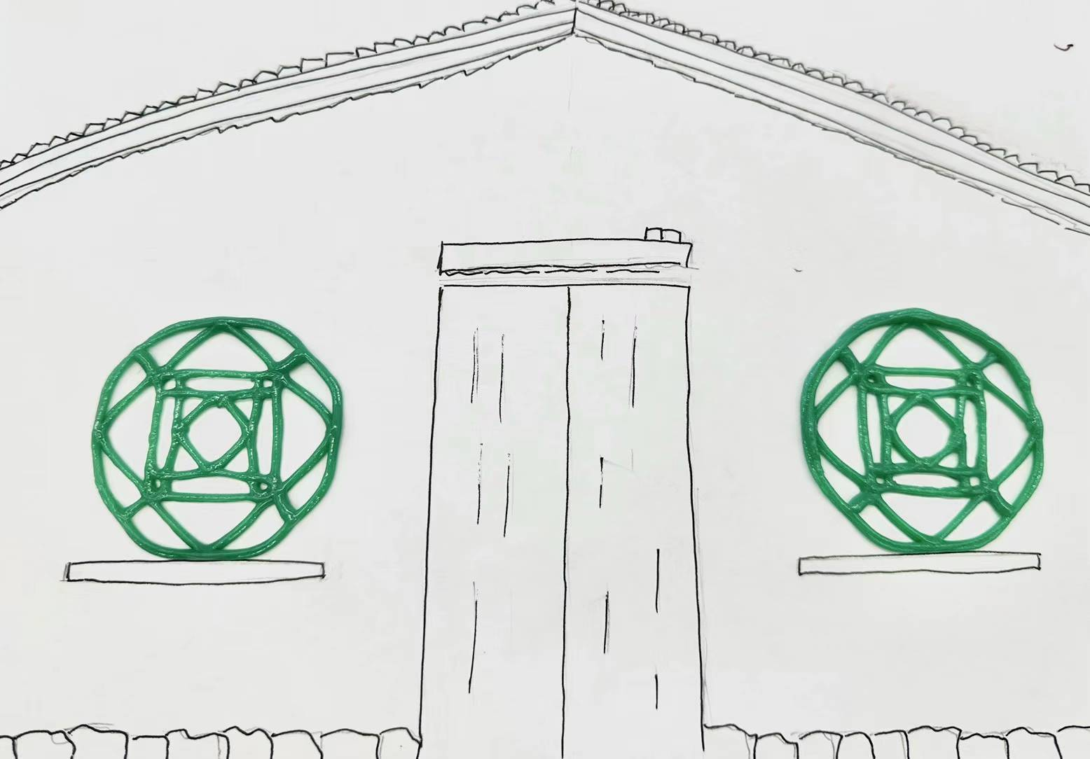
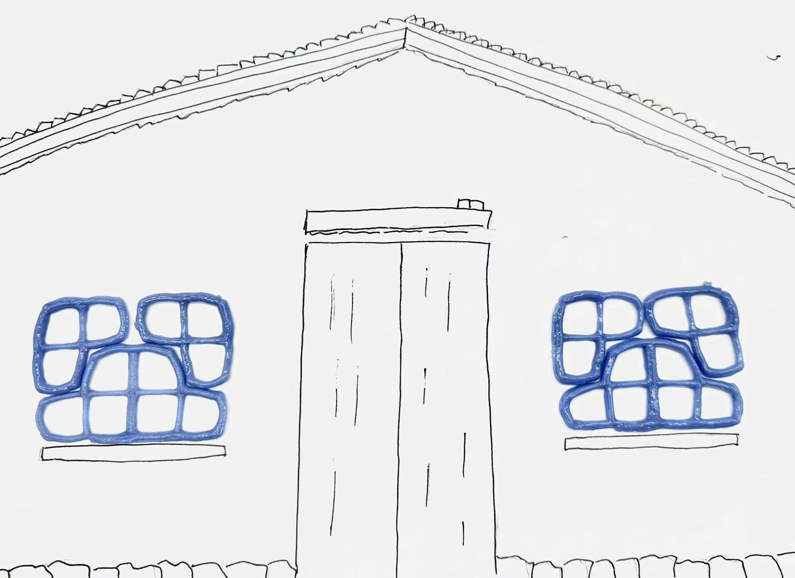
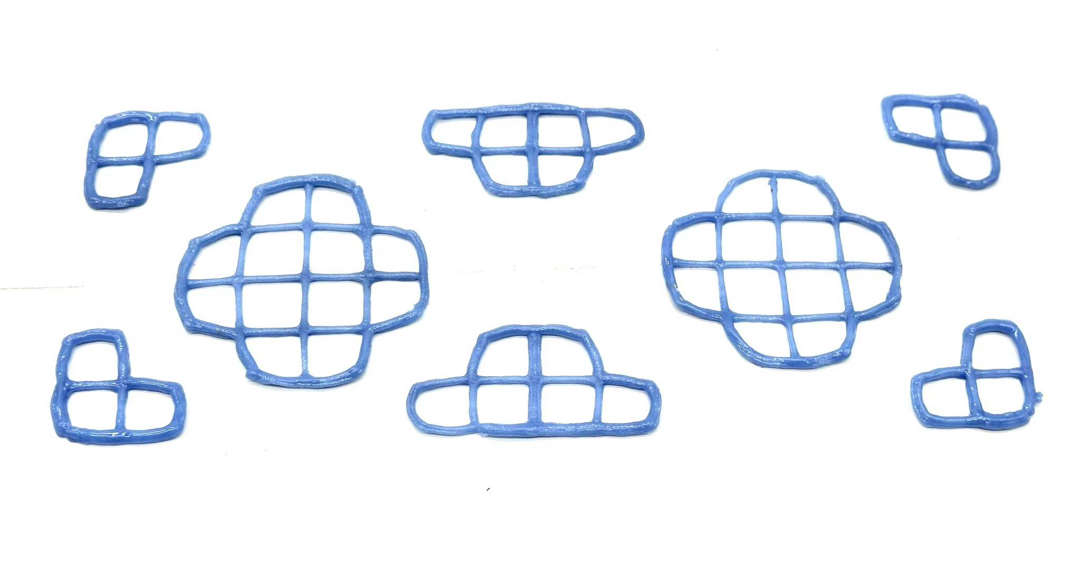

Slide 12
Thank You!
Qinghong Shao
Hand and Machine Lab
University of New Mexico
Acknowledgements: Prof. Leah, Dr. Fiona, Camila Friedman-Gerlicz
Notes:
Finally, I need to thank Prof.Leah, Doc.Fiona, and Camlia for their inspiration and guidance on my last project.

